Slide 1




LIBRARY MANAGEMENT SYSTEM
S KRITHIKA - RA2311003020416

Slide 2
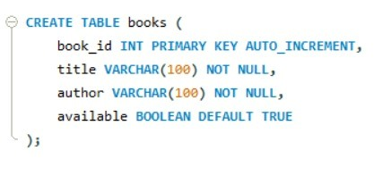
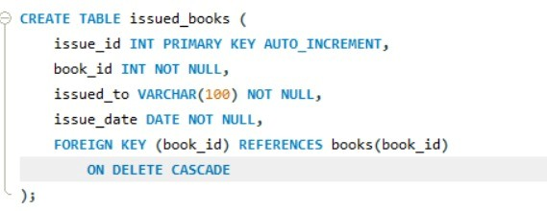
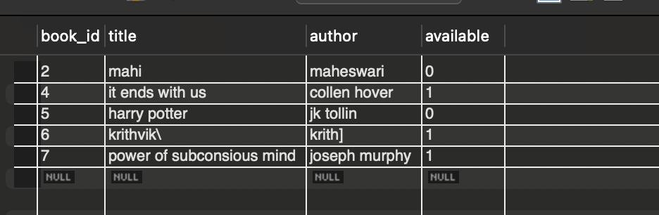
CREATE OPERATION (Table Creation)
To define the structure of the database tables.
To store book and issue-related information.
To establish relationships between tables.
books table stores book details.
issued_books table stores issued book details.
book_id is the primary key.
Foreign key ensures data consistency.
available column tracks book status

Slide 3
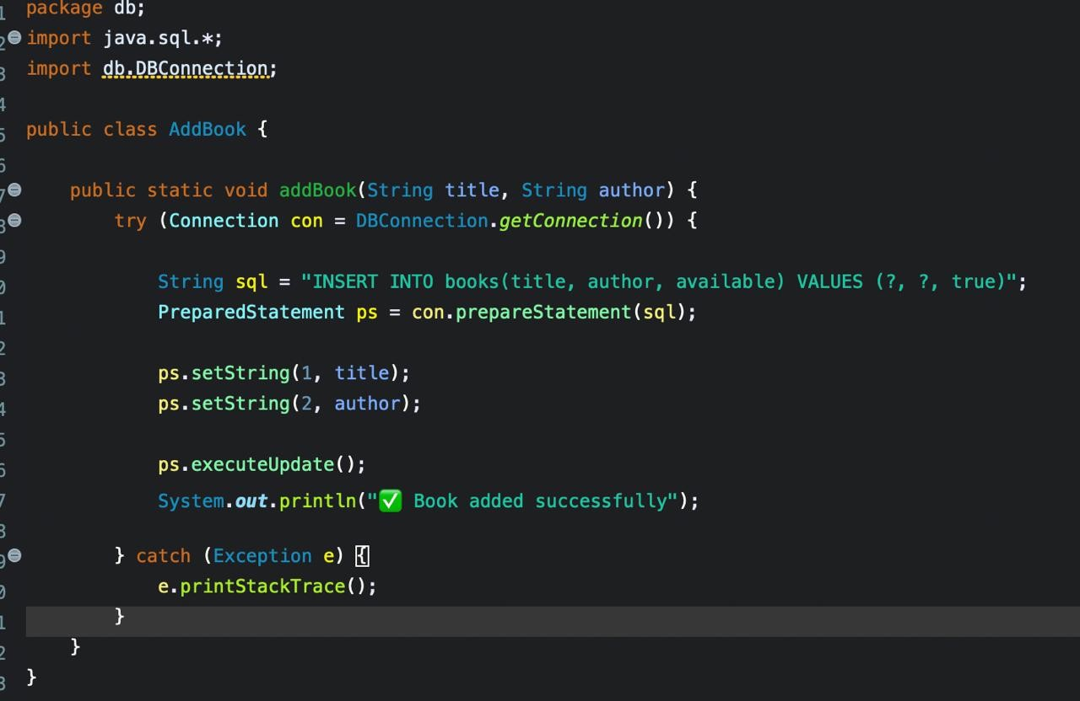
INSERT OPERATION (ADD)
To add new books into the library.
To record issued books and issue details.
New book details are stored in books table.
Issued book details are stored in issued_books table.
PreparedStatement is used for security.
Default availability is set to true.
Issue date is stored using CURDATE().

Slide 4
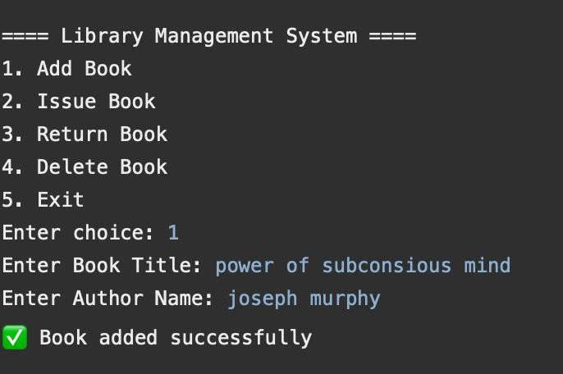
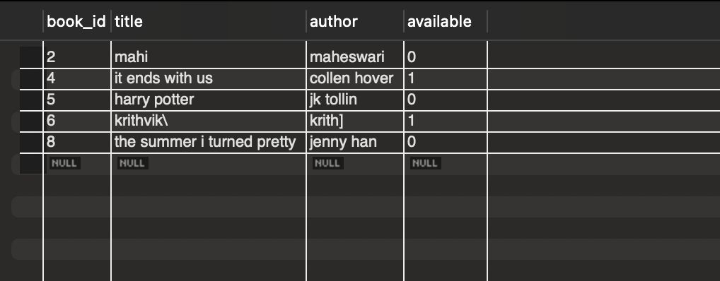
INSERT OPERATION (ADD)

Slide 5
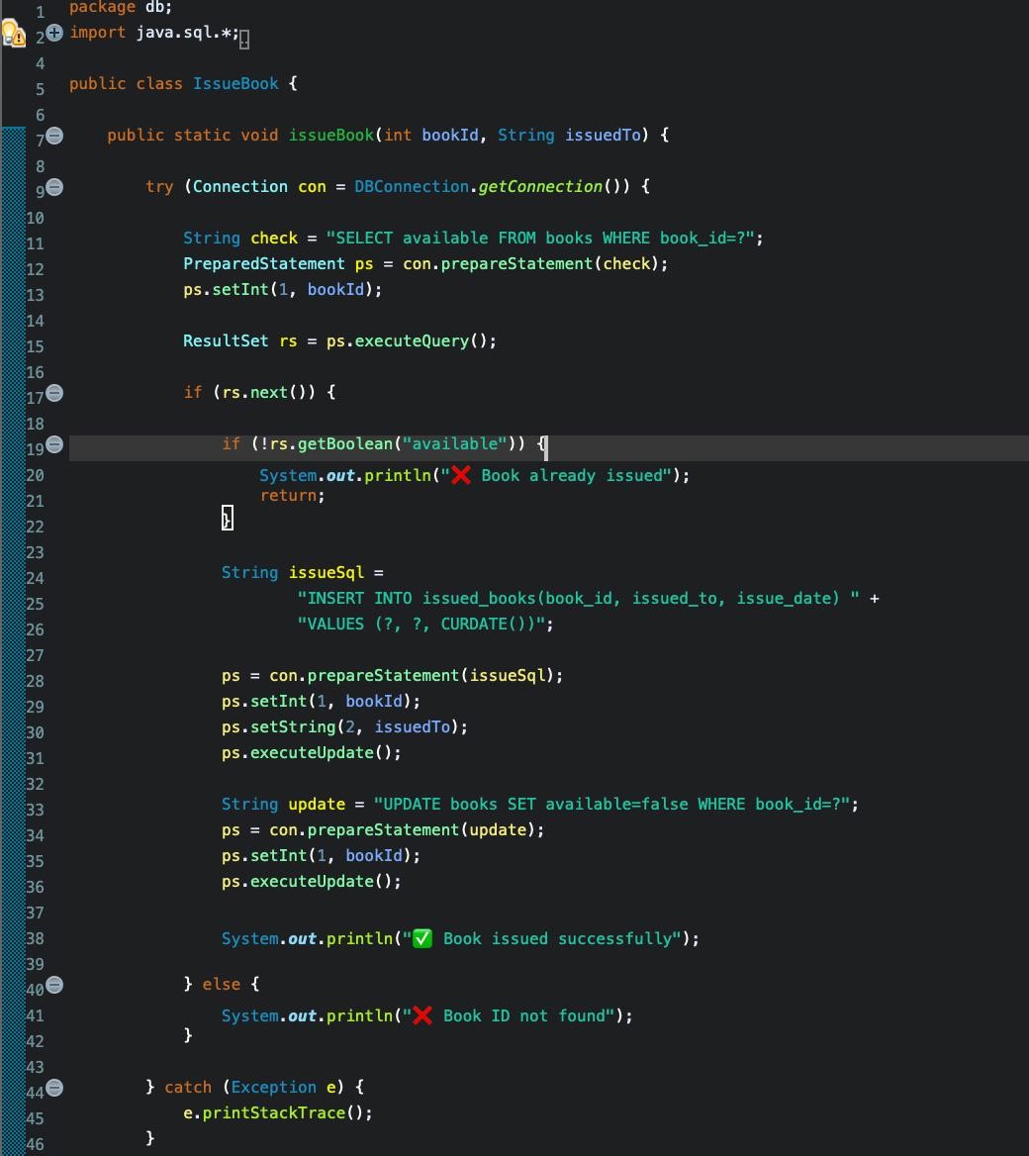
UPDATE OPERATION (ISSUE)
To change book availability status.
To manage issuing and returning of books.
Availability set to false when issued.
Availability set to true when returned.
Prevents issuing an already issued book.
Ensures real-time book status tracking.

Slide 6
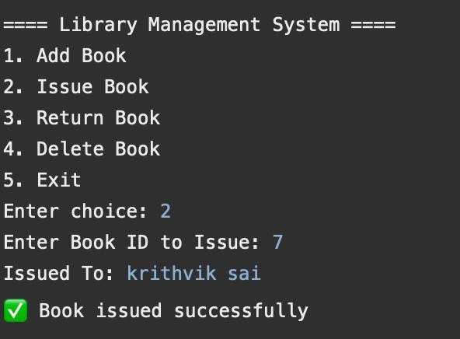
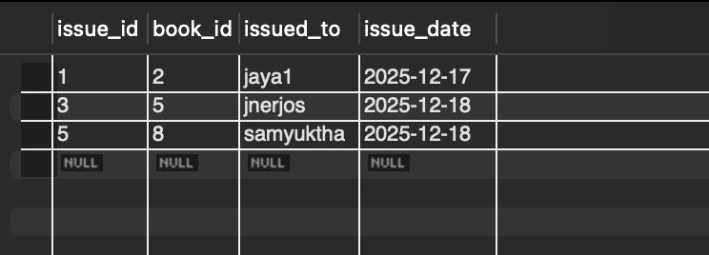
UPDATE OPERATION (ISSUE)

Slide 7
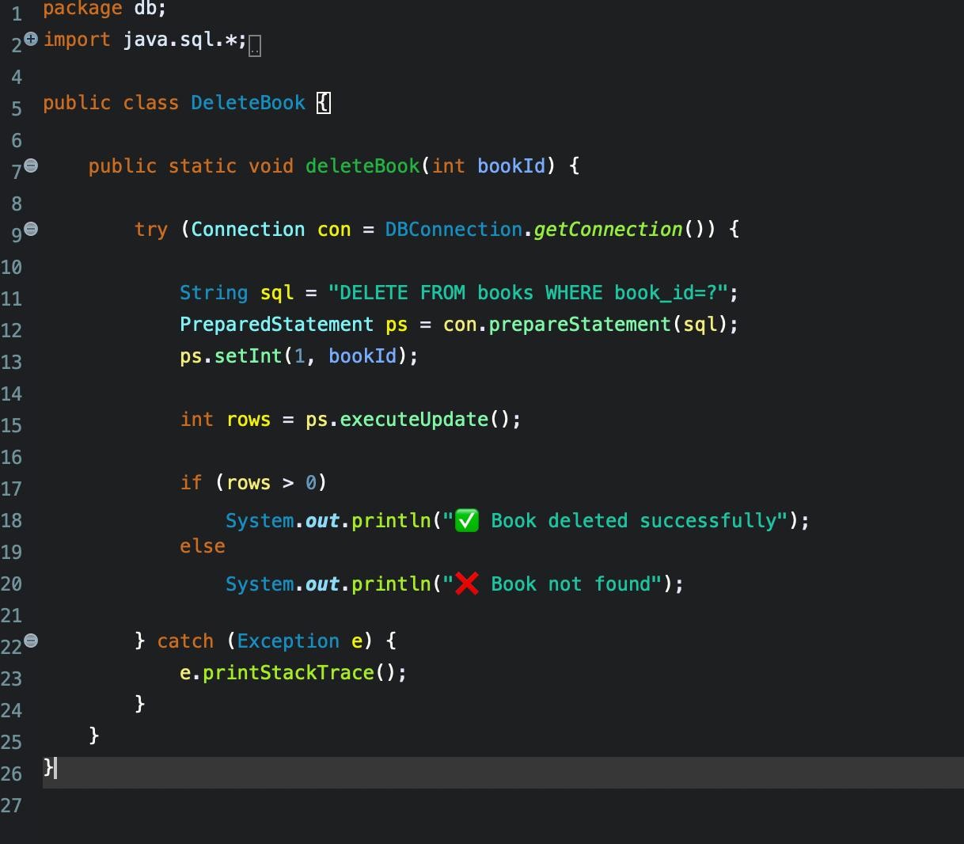
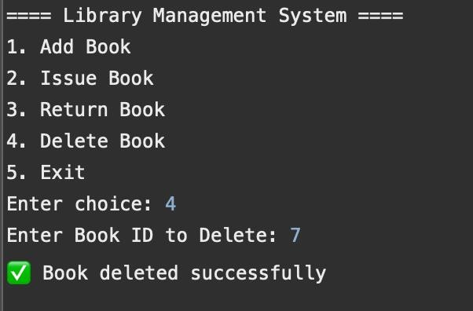
DELETE OPERATION
To remove issued book records after return.
To permanently delete books from the library.
Issued record is deleted during return.
Book can be removed permanently if needed.
Ensures database remains clean.
Checks if record exists before deletion.

Slide 8
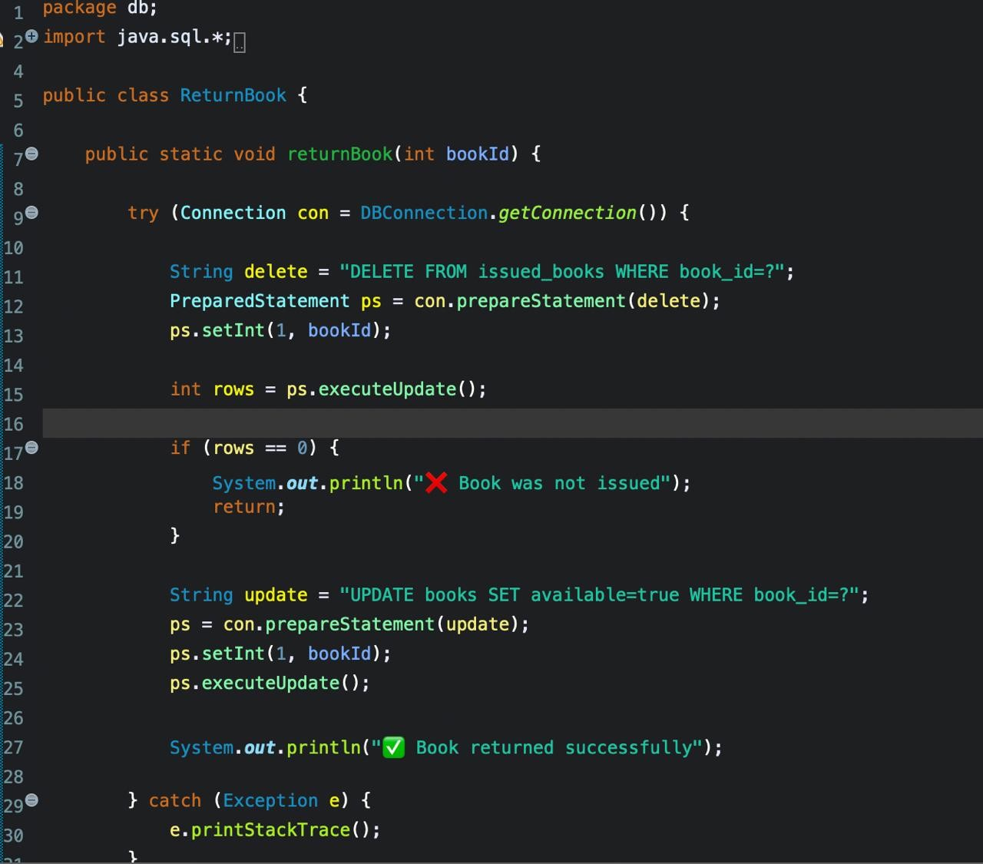
RETURN OPERATION
To remove issued book records after return.
To permanently delete books from the library.
Issued record is deleted during return.
Book can be removed permanently if needed.
Ensures database remains clean.
Checks if record exists before deletion.

Slide 9
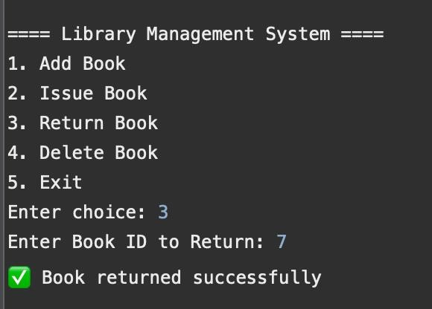
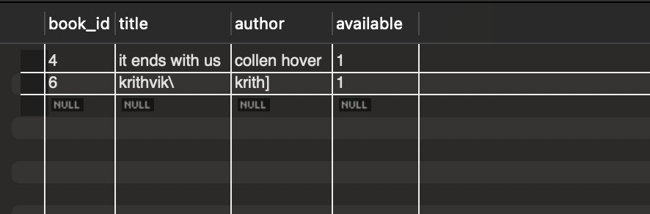
RETURN OPERATION

Slide 10
THANK YOU !!

